Slide 1
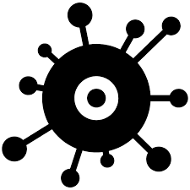
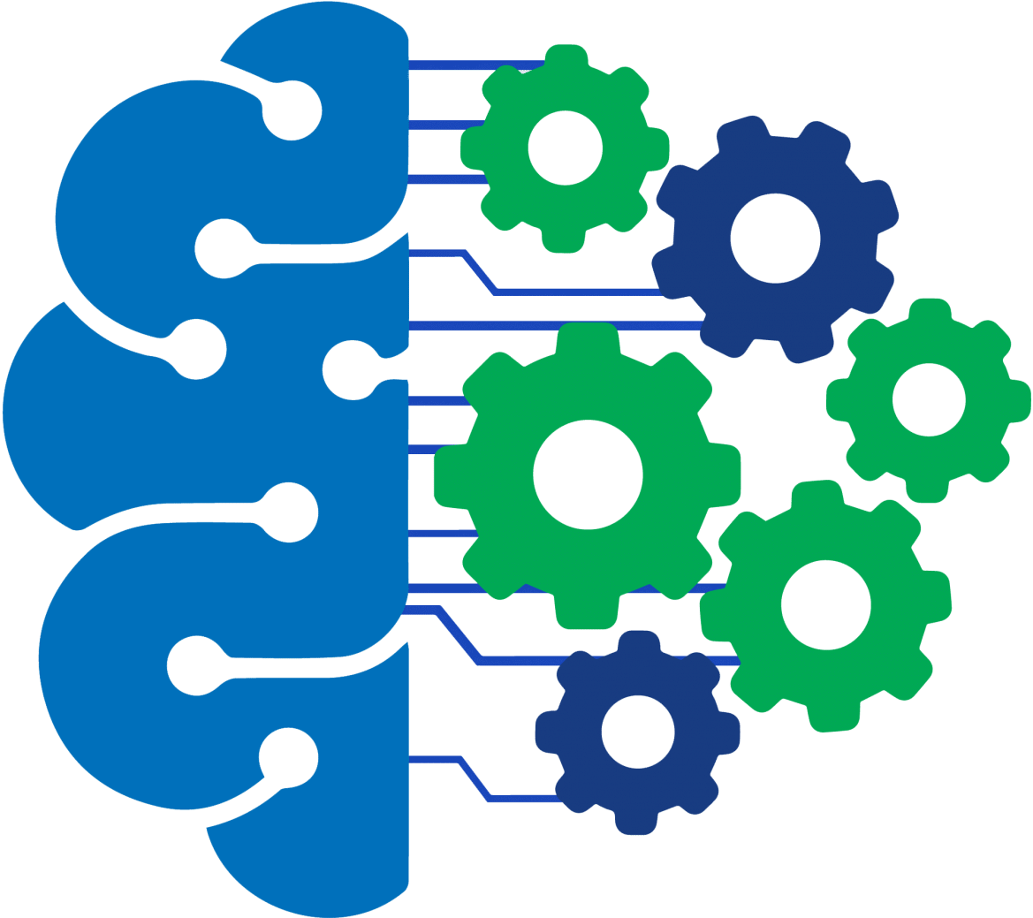
Data-Driven Disease Prediction

Slide 2

Our Team
Geethika (Team Leader)
Jyothesh (Data Scientist)
Ravi Prasad (Data Visualization)
Medha (Data Modelling)

Slide 3
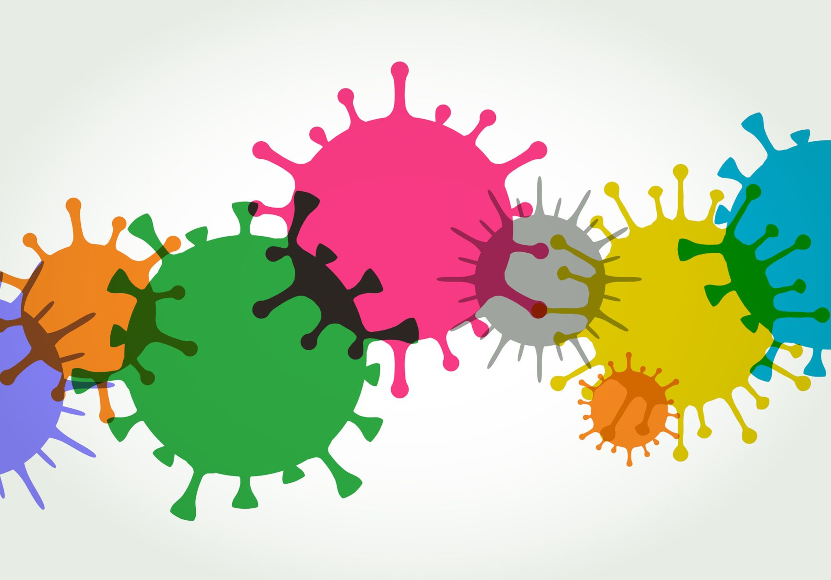
PROBLEM STATEMENT
Identifying diseases from symptoms is a challenge that necessitates the development of effective methods or tools to enable individuals to diagnose their conditions based on presented symptoms.

Slide 4
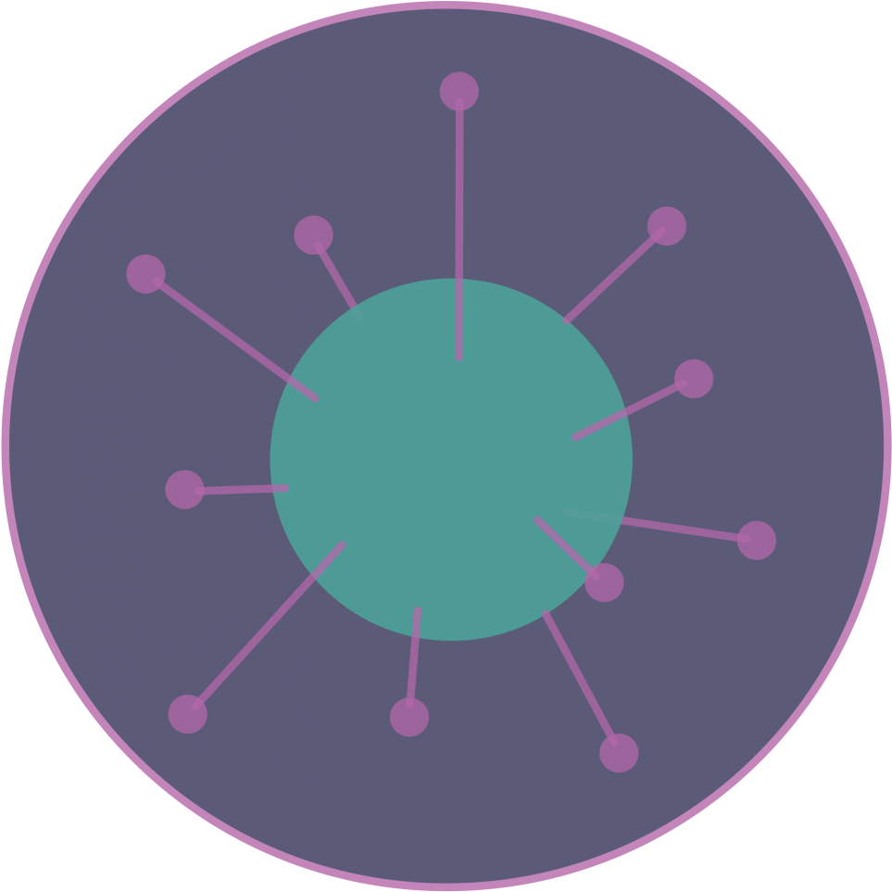
Introduction
AIM
OUTCOME
Based on the symptoms of the patients, trained model will predict the disease and suggest the best doctor to cure the disease of patient.
This project aim is to provide a system where all the problem or disease that patient is facing is cured effectively and accurately based on their symptoms using machine learning technology.
FUNCTIONALITY
Patient symptoms will be given as input in the system then these inputs will go through the ML trained module to predict the disease.

Slide 5

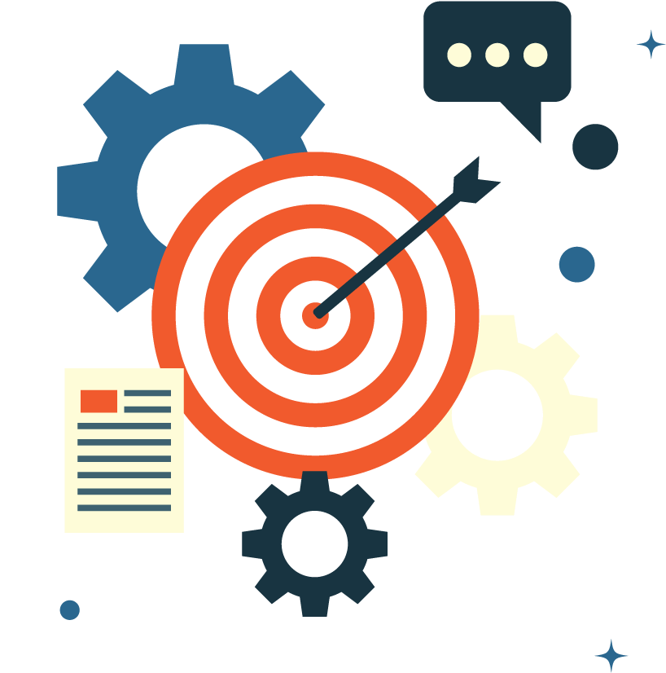
OBJECTIVE
This project aim is to provide a system where all the problem or disease that patient is facing is cured effectively and accurately based on their symptoms. With the advancement of the technology our traditional system of disease identification or prediction also need to be advance so that patients can be satisfied and get the treatment hassle-free.
JUPITER

Slide 6




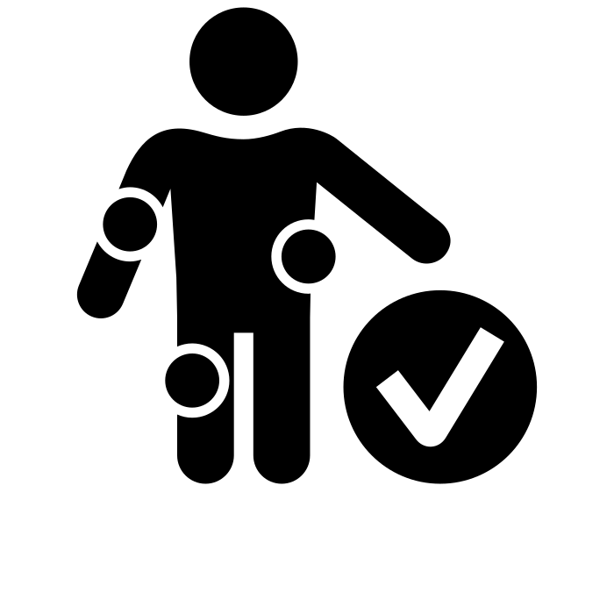


Disease Prediction & Doctor Suggestion(Crisp DM Methodology)
Data Collection
Data Cleaning
Train Model
Model Selection
Passing Symptoms
Disease Prediction
Doctor Suggestion
Treatement

Slide 7
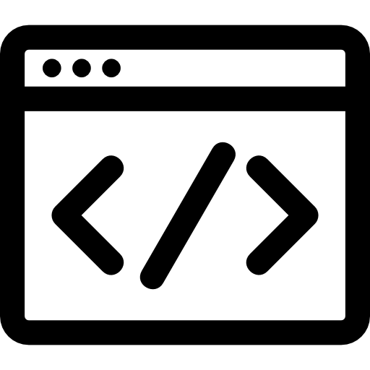

Tools and Frameworks Used
Machine Learning
Frontend Web Interface
Backend Web Interface
Data Storage
Python
Scikit Learn
Django
Python
JavaScript
Python Pickle
PostgreSQL
HTML
CSS
Bootstrap
jQuery

Slide 8
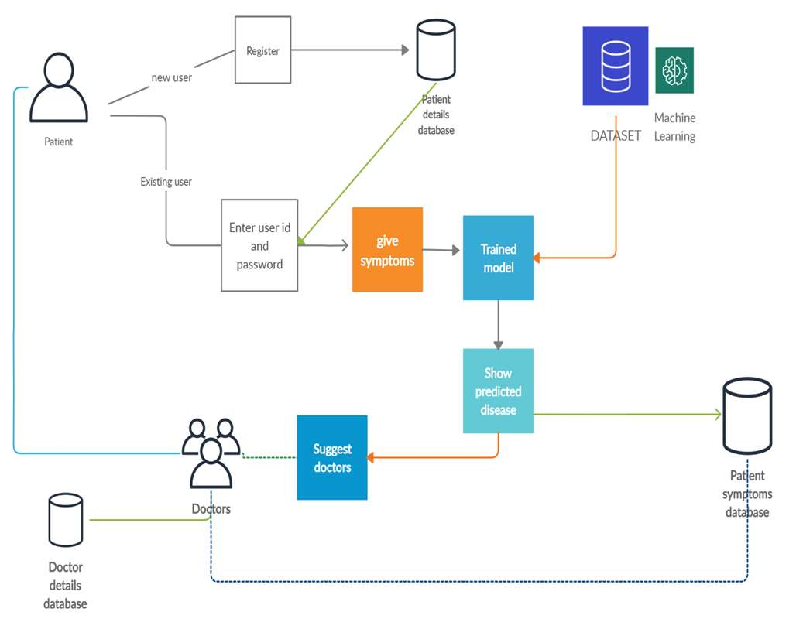
Working of the Project
This project provide an effective system for patients where patients can feed symptoms into this tool as a input, which will be process and go through the machine learning module and then predict the possible disease to the patient.
Finally, a doctor will be suggested by the system to cure the predicted disease of the patient.

Slide 9
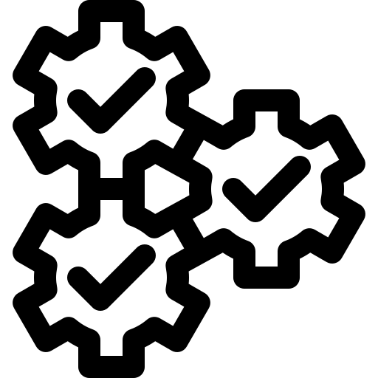
WorkFlow
Phase 1
Phase 2
Phase 3
Phase 4
Machine learning module will be trained using dataset to predict the diseases and find out which algorithm gives the maximum accuracy on the supplied dataset.
Integration of the trained module with Django rest framework for web development using Python, HTML, Bootstrap, CSS.
Use the trained module to predict disease and suggest doctors based on result for treatment.
Data collection has been done from the internet to identify the disease here the real symptoms of the disease are collected i.e. no dummy values are entered.

Slide 10
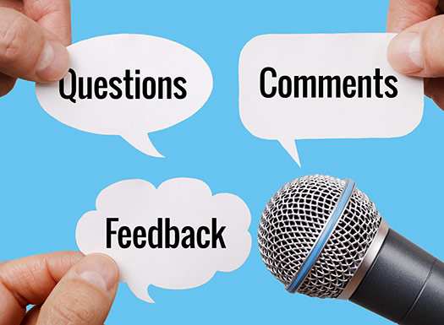

Slide 11
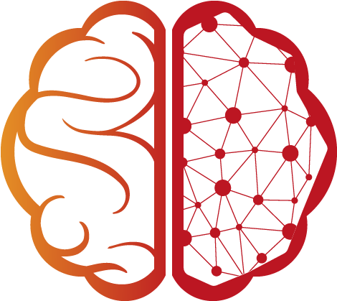
THANKYOU!!

